Slide 1
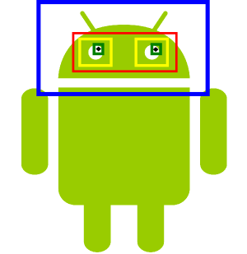
Using mobile gaze-detection for user centric research
André Pomp
Supervisor: Jó Agila Bitsch Link, Oliver Hohlfeld
Aachen / Master Initial Talk, May 2014

Slide 2




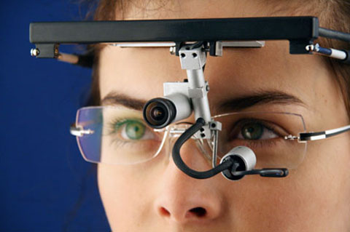
Motivation
Many people use mobile apps all over the day
How good are they?
Evaluation by using Quality of Experience (QoE)
Measure of a customer’s experience
Evaluating QoE of apps using gaze-tracking
Professional gaze-tracking systems are expensive
Testing environment/equipment is unnatural
Can lead to unusual or unexpected behavior
Can influence the results
We need a mobile and natural QoE approach

Slide 3
Goals
Use mobile gaze-tracking for QoE experiments
Use of smartphones and tablets
Develop a user-friendly mobile app that allows to make QoE experiments more realistic on mobile devices
Identify use cases for which mobile gaze-tracking can be used
Use Cases:
Second screen evaluation
Evaluating web sites
Comparison to professional gaze-tracking system
Open Source

Slide 4

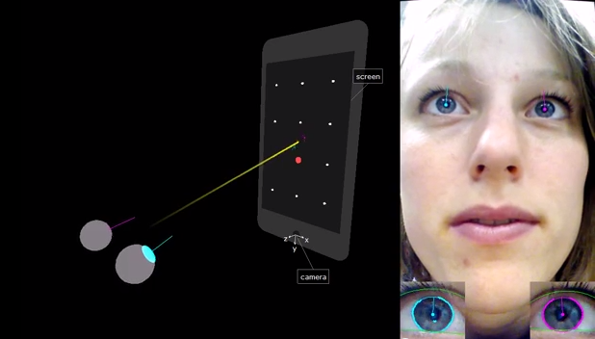
What is already there ?
OpenCV
Computer Vision Library for C++, Python, Java
Can be used for Java/Android via Java Native Interface
EyeTab
Library developed in C++ and Python
Allows for eye detection and gaze-tracking
uses OpenCV
+ No per-user calibration necessary
- Requires special position and distance

Slide 5

What will I do?
Port existing gaze-tracking library (EyeTab) to Android
Develop a QoE application that uses gaze-tracking
Record video of front camera
Live gaze-tracking or post processing
Record screen of mobile device
Logging of various sensor data (accelerometer, gyroscope …)
Setup of a benchmarking library for gaze-tracking videos
Publish videos of people and the positions they are looking at
Evaluation of other approaches against this library possible

Slide 6
Evaluation
Learn about the behavior of users
Identify position how users hold their mobile device
Identify accuracy of the used gaze-tracking approach in natural scenarios
Identify and evaluate use cases for mobile gaze-tracking
Second screen evaluation
Identifying of regions a user is looking at
Comparison to professional gaze-tracking glasses
Find use cases that do not require a professional gaze-tracking device

Slide 7
Challenges
Bad camera resolutions of front camera
Mobile devices have limited battery / processing power
Varying light conditions
Daylight, artificial light, no light
Varying positions for holding a mobile device
(reverse) landscape, (reverse) portrait
Perhaps eyes are not visible for the camera
Perhaps change to offline post processing

Slide 8


Timetable
Implementation (9 weeks)
4 weeks
Port existing gaze tracking library to Android
5 weeks
Application development for mobile gaze tracking
Application development for evaluation approaches
Evaluation (8 weeks)
2 weeks
Learn about the behavior of users
6 weeks
Evaluate use cases and compare to professional gaze-tracking system
Writing (6 weeks)
Buffer (1 week)

Slide 9
Conclusion
Natural, user-friendly , mobile gaze-tracking approach
No labor or expensive equipment necessary
Gaze-tracking in everyday life for QoE studies
Could allow for evaluating usability of apps
Open Source and available to the public

Slide 10
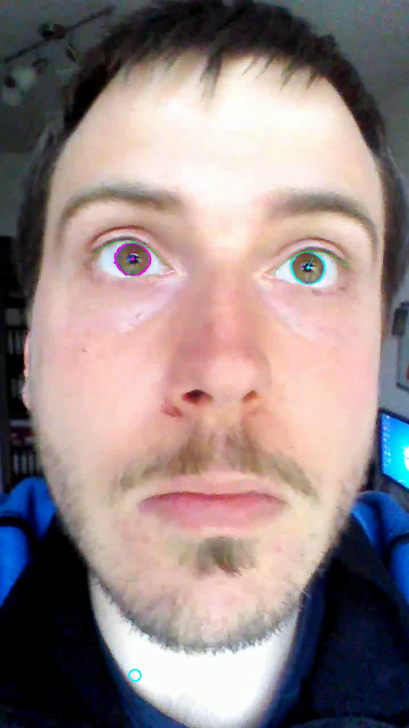
Video

